Slide 1
Predicting Customer Order Cancellations Through Behavioral Insights
A Data-Driven Approach to Reducing Order Cancellations and Improving E-Commerce Retention
COMPANY NAME

Slide 2
Outline
Business Problem
Dataset Overview
Handle Inconsistent & Missing Data
Customer Behaviour Analysis
Machine Learning Model Goal
Data Preparation Steps
Modeling Pipeline
Finalized Model
Model Deployment Ready
Business Recommendations
Conclusion

Slide 3
Business Problem
The Challenge
In the e-commerce industry, approximately 30% of customer orders are being cancelled. This high cancellation rate directly impacts revenue, inventory planning, customer satisfaction, and operational efficiency.
Objective
To identify patterns in customer behavior that lead to order cancellations, and to develop a predictive solution that can:
Detect high-risk orders before cancellation happens
Uncover the most influential factors driving cancellations
Recommend targeted interventions to reduce cancellation rates

Slide 4
Handle Inconsistent & Missing Data
Add-ons Purchased
Missing values filled with: "No Add-on Purchased"
Gender
Missing values filled using the mode.
Payment Method
Fixed inconsistent spelling: "Paypal" ➝ "PayPal"
Age Groups
To simplify age-related analysis, we binned the continuous Age feature into three broad categories:
18 – 30 -> Younger
31 – 50 -> Middle-Aged
51 and above -> Older

Slide 5
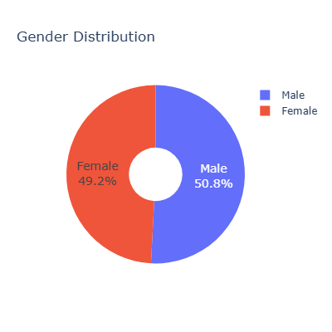
Customer Behaviour Analysis
Who Are Customers?
Gender-wise Order Distribution
Male – 50.8%
Female – 49.2%
The distribution is nearly balanced — so gender is not a major driver of cancellation behavior on its own.

Slide 6
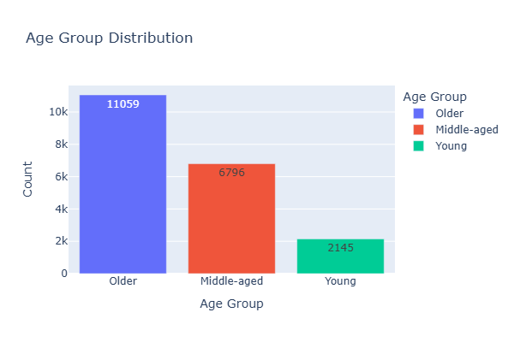
Age Group Distribution
Older Adults: 11,059 customers (largest group)
Middle-Aged Adults: 6,796 customers
Young Adults: 2,145 customers (smallest group)
The majority of customers are older adults — this may influence product preferences, payment habits, and cancellation risk.

Slide 7
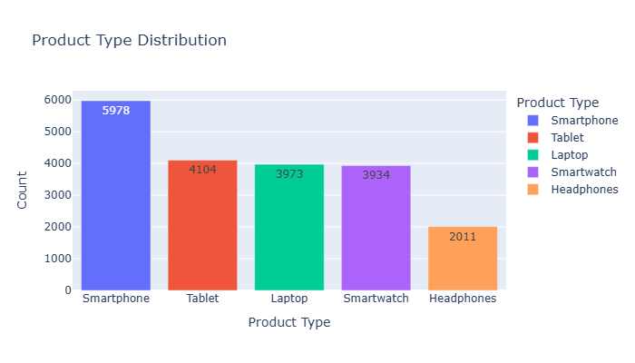
What Do They Buy and How?
Product Type Distribution
Smartphones lead with the highest orders (5,978).
Tablets, Laptops, and Smartwatches have similar demand (~4,000 each).
Headphones have the lowest orders (2,011).
Indicates strong demand for smartphones and balanced interest in other tech categories.

Slide 8
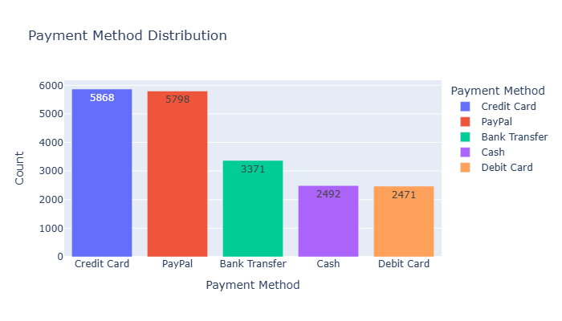
Shipping Type Preferences
Standard Shipping is the most used option — 6,725 orders
Other methods like Express (3,366), Overnight (3,357), Same Day (3,280), and Expedited (3,272) are used fairly equally
Standard is the most common shipping choice — but it may come at a risk.

Slide 9
Payment Method Distribution
PayPal (5,798) and Credit Card (5,868) are the most preferred methods.
Bank Transfer comes next with 3,371 orders.
Cash (2,492) and Debit Card (2,471) are least used.
Indicates a customer preference for digital payments over cash or debit.

Slide 10
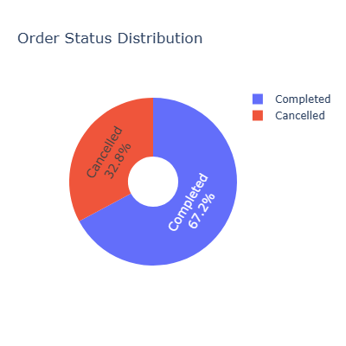
Order-Outcomes
Order Status Distribution
Completed Orders: 67.2%
Cancelled Orders: 32.8%
Nearly 1 in 3 orders gets cancelled, highlighting a significant business concern worth investigating.

Slide 11
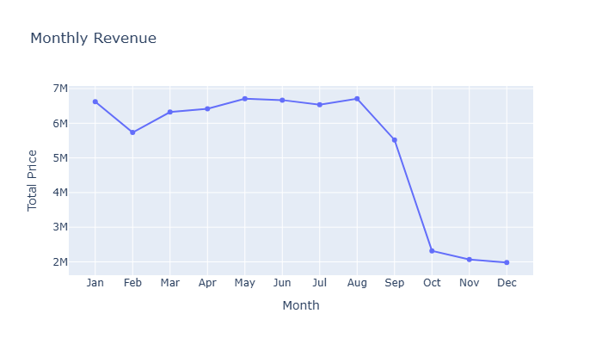
Monthly Revenue Trend
Monthly Revenue Trend
Revenue peaked around May–August (₹6.5M–₹6.8M)
Sharp decline starts in September, dropping to ~₹2M by December
Possible cause: Rise in cancellations, lower purchase activity, or customer dissatisfaction
he business faces a major revenue drop in the last quarter — highlighting the importance of predicting and preventing cancellations.

Slide 12
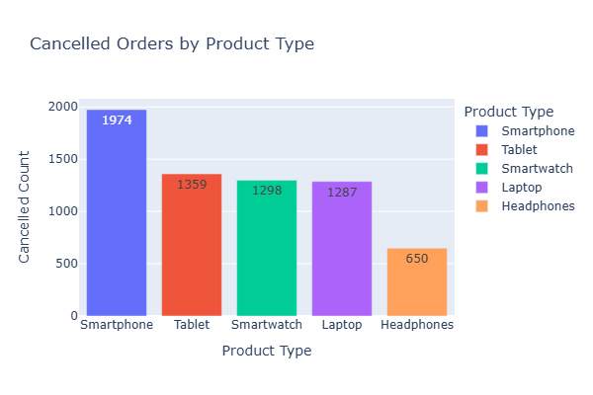
Why Do Cancellations Happen?
Cancellations by Product Type
Smartphones have the highest cancellations — 1,974 orders
Tablets are second — with 1,359 cancellations
Other product types have significantly fewer cancellations
High-value electronics like smartphones and tablets are more likely to be canceled — possibly due to price sensitivity, delivery delays, or change of mind

Slide 13
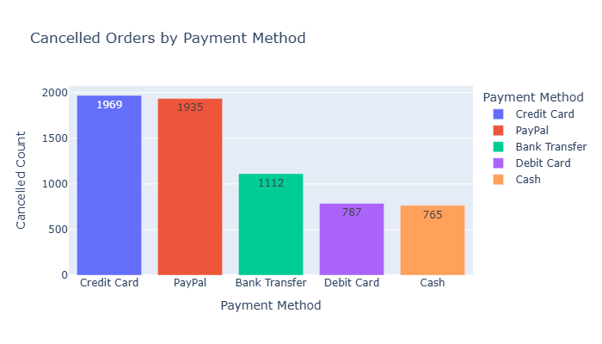
Cancellations by Payment Method
Credit Card has the highest cancellations — 1,969 orders
PayPal follows closely — 1,935 cancellations
Other payment methods have fewer cancellations in comparison
Most cancellations come from customers using Credit Cards and PayPal — possibly because these methods offer easy refunds or buyer protection, increasing the likelihood of order reversals.

Slide 14
Cancellations by Shipping Type
Standard Shipping leads to the most cancellations — 2,164 orders
Express Shipping follows with 1,139 cancellations
Other shipping types show lower cancellation rates
Cancellations are significantly higher with Standard Shipping, possibly due to longer delivery times or unmet expectations.

Slide 15
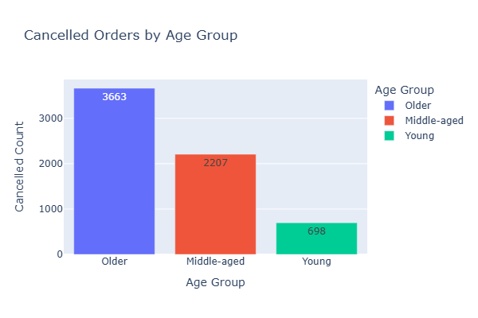
Cancellations by Age Group
Older Adults canceled the most orders — 3,663 cancellations
Middle-Aged Adults followed with 2,207 cancellations
Young Adults contributed the least
Older customers not only form the largest customer group, but also account for the highest number of cancellations, suggesting targeted engagement or support strategies may be needed.

Slide 16
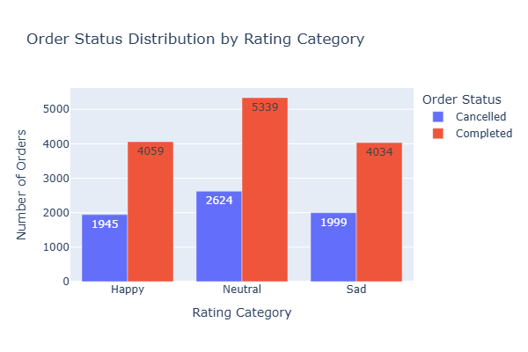
Cancellations by Customer Rating
Neutral ratings had the most cancellations — 2,624 orders
Sad ratings followed closely — 1,999 cancellations.
Even Happy customers canceled 1,945 orders.
Even customers with positive ratings cancel, but cancellations are highest among Neutral and Sad rating groups — indicating dissatisfaction may lead to order reversals.

Slide 17
Modeling Goal
Objective: Predict whether an order will be Cancelled or Completed

Slide 18
Data Preparation Steps
Converted Order Status into binary (0 = Completed, 1 = Cancelled)
Defined input and target columns
Train-test split to prepare for modeling
Label Encoding: Age Group, Rating Category
One-Hot Encoding: Gender, Loyalty, Product Type, Shipping, Payment
Numeric Features: Quantity, Total Price, Add-on, Purchase Month, Weekday, Year
Combined preprocessing using ColumnTransformer

Slide 19
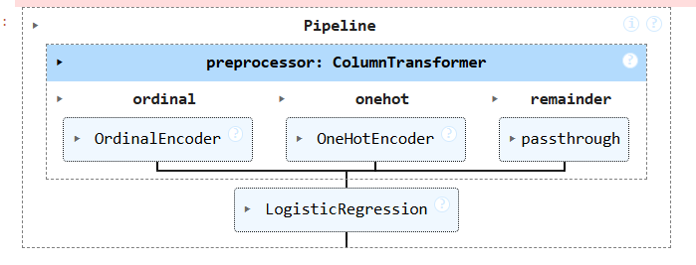
Modeling Pipeline (Logistic Regression)
Built a pipeline with:
preprocessor (all encodings + scalers)
LogisticRegression with class_weight='balanced'
Accuracy Score: 0.515
Classification Report: (show or summarize)
Low precision/recall — underfit
Logistic Regression underperformed — explored better models

Slide 20
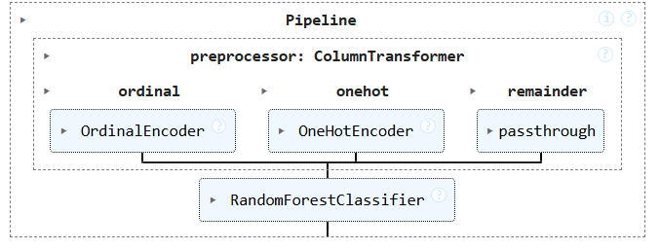
Improved Model: Random Forest Classifier
Switched to RandomForestClassifier
Accuracy Improved: 0.655
Better classification performance across all metrics
Random Forest is selected as the final model

Slide 21
Model Deployment Ready
Deployment Summary
Final model saved using pickle
Supports real-time prediction with probability
Results With Sample Input 1
Prediction: 🟥 Cancelled
Cancellation Probability: 72%
Random Forest is selected as the final model
Sample Input 01
{
Age Group: "Older", Rating: "Neutral",
Quantity: 2, Total Price: 4999,
Product: "Smartphone", Shipping: "Standard",
Payment: "Credit Card", Loyalty: "No", ...
}

Slide 22
Results With Sample Input 2
Prediction: ✅ Completed
Completion Probability: 64%
Sample Input 02
{
Age Group: "Younger", Rating: "Happy",
Quantity: 2, Total Price: 30000,
Product: "Laptop", Shipping: "Express",
Payment: "Debit Card", Loyalty: "Yes", ...
}

Slide 23
Business Recommendations
Improve Standard Shipping experience – partner with reliable couriers or set clearer delivery timelines
Support Older Customers – simplify website layout for better readability and send reminders or offers to reduce drop-offs,
High Credit Card Cancellations – check with dev team for payment flow issues or checkout errors
Smartphones & Tablets have high cancellations – improve product info and clarify return policies.
Use the model to flag risky orders – follow up with calls, offers, or priority handling

Slide 24
Conclusion
In summary, we identified key factors contributing to order cancellations, including product type, shipping method, and customer demographics. By building a predictive model—where Random Forest performed best—we can now flag high-risk orders before dispatch. These insights, combined with targeted business actions, enable smarter decision-making and improve customer satisfaction. The model is ready for real-world deployment, helping the business reduce cancellations and optimize operations.

Slide 25
Thank You
Thank you for your time and attention.
Project By
Dhwani Zala
Email: dhwanizala25@gmail.com

